Slide 1

Domain: Deep Learning Technology: Python
DETECTING DIABETIC RETINOPATHY USING DEEP LEARNING

Slide 2
INDEX
ABSTRACT
INTRODUCTION
LITERATURE REVIEW
EXISTING METHOD
PROPOSED SYSTEM
BLOCK DIAGRAM
ARCHITECTURE
SYSTEM SPECIFICATIONS
SYSTEM DESIGN
RESULTS
CONCLUSION
REFRENCES

Slide 3
ABSTRACT
Diabetic Retinopathy (DR) is a human eye disease that occurs in diabetics and causes retinal damage, which can lead to blindness in the long run. DR is currently being manually screened by ophthalmologists, which is a time-consuming procedure. And from now on, this task (project) will concentrate on analyzing various DR stages using Deep Learning (DL), a subset of Artificial Intelligence (AI). We trained a model called MobileNet on a massive dataset of 3662 train images to detect the DR stage and classify them into high resolution fundus images. Kaggle hosts the dataset that we are using (APTOS). There are five DR stages: zero, one, two, three, and four.
In this paper, fundus eye images from patients are used as input parameters. A trained model will then extract features from fundus images of the eye, and an activation function will provide the output. This architecture detected DR with an accuracy of 0.9611 (quadratic weighted kappa score of 0.8981). Finally, we compare the two MobileNet architectures.

Slide 4
INTRODUCTION
DR is the most debilitating form of diabetes in which serious damage occurs to the retina and causes visual impairments. It harms the veins inside the retinal tissue, making them spill fluid and contort vision. Alongside maladies prompting visual impairment like, waterfalls and glaucoma, DR is one of the most continuous diseases. There are five stages of DR that is 0, 1, 2, 3, and 4. The below table gives the overall details about DR Each stages has its own symptoms and specific properties, now from normal images doctors can not specify the DR stages. Moreover existing methods for diagnosing are very inefficient because it takes very large time, due to which the treatment may go the wrong way.
To detect retino-pathy doctors used fundus camera which takes the picture of veins and nerves which is behind the retina. The initial phase of this disease has no signs of DR, so it turns into a real challenge to recognize it into a starting stage. For early detection we have used the different

Slide 5
MobileNet algorithms, so that doctors can start the treatment at the correct time. In this paper the dataset which we are using for the project is collected from “Aravind Eye Hospital” and it is available on Kaggle that is “APTOS (Asia Pacific TeleOphthalmology Society)”. We compare the two MobileNet architectures and showing the results of these two architectures. In recent projects and researches, AI models, and in AI specially “Deep Learning” gives the most accurate outputs in finding hidden layers in various AI tasks, particularly in the field of medical image analysis. Based on the deep learning models which are classify diseases and support medical decision making and can improve the persistent consideration (extra care).

Slide 6
LITERATURE REVIEW
S. No | Journal Type with year | Authors | Title | Outcomes
1 | MDPI, 2017 | Kele Xu, Dawei Feng, and Haibo Mi | Deep Convolutional Neural Network-Based Early Automated Detection of Diabetic Retinopathy Using Fundus Image | In this paper, we explored the use of deep convolutional neural network methodology for the automatic classification of diabetic retinopathy using color fundus image, and obtained good accuracy on our dataset, outperforming the results obtained by using classical approaches.
2 | AMIA, 2018 | Lam C, Yi D, Guo M, Lindsey T | Automated Detection of Diabetic Retinopathy using Deep Learning | In this paper, we demonstrate the use of convolutional neural networks (CNNs) on color fundus images for the recognition task of diabetic retinopathy staging.
3 | JAMA, 2016 | Varun Gulshan, Subhashini Venugopalan, Rajiv Raman | Development and Validation of a Deep Learning Algorithm for Detection of Diabetic Retinopathy in Retinal Fundus Photographs | The algorithm was evaluated at 2 operating points selected from the development set, one selected for high specificity and another for high sensitivity.
4 | ISSPIT, 2019 | Sara Hosseinzadeh Kassani, Peyman Hosseinzadeh Kassani, Reza Khazaeinezhad, Michal J. Wesolowski et al | Diabetic Retinopathy Classification Using a Modified Xception Architecture | In this paper, we present a new feature extraction method using a modified Xception architecture for the diagnosis of DR disease.

Slide 7
EXISTING METHOD
This model emphasizes an existing method that which is designed using the some of the algorithms of machine learning. Here the process is performed using the ANN, which is one of the transfer learning methods, but this could not get the high accuracy.
DRAW BACKS:
Less feature compatibility
Low accuracy

Slide 8
PROPOSED SYSTEM
In purposed method we are performing the classification of either the diabetic retinopathy identification using MobileNet of deep learning along with the machine learning methods. As image analysis based approaches for diabetic retinopathy detection. Hence, proper classification is important for the proper retinopathy that which will be possible by using our proposed method. Block diagram of proposed method is shown below.
ADVANTAGES:
Accurate classification
Less complexity
High performance
Easy identification

Slide 9
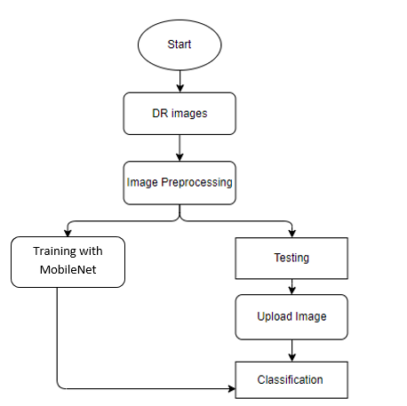
BLOCK DIAGRAM

Slide 10
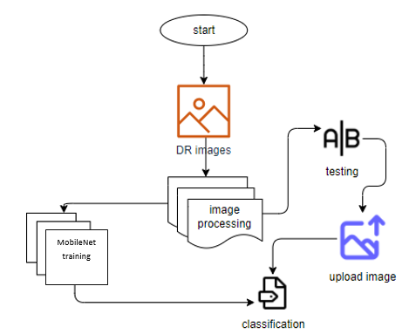
ARCHITECTURE

Slide 11
UML DIAGRAMS
UML stands for Unified Modelling Language. UML is a standardized general-purpose modelling language in the field of object-oriented software engineering. The standard is managed, and was created by, the Object Management Group.
The goal is for UML to become a common language for creating models of object-oriented computer software. In its current form UML is comprised of two major components: a Meta-model and a notation. In the future, some form of method or process may also be added to; or associated with, UML.
The Unified Modelling Language is a standard language for specifying, Visualization, Constructing and documenting the artifacts of software system, as well as for business modelling and other non-software systems.

Slide 12
The UML represents a collection of best engineering practices that have proven successful in the modelling of large and complex systems.
The UML is a very important part of developing objects-oriented software and the software development process. The UML uses mostly graphical notations to express the design of software projects.
GOALS:
The Primary goals in the design of the UML are as follows:
Provide users a ready-to-use, expressive visual modelling Language so that they can develop and exchange meaningful models.
Provide extendibility and specialization mechanisms to extend the core concepts.
Be independent of particular programming languages and development process.

Slide 13
Provide a formal basis for understanding the modelling language.
Encourage the growth of OO tools market.
Support higher level development concepts such as collaborations, frameworks, patterns and components.
Integrate best practices.
USE CASE DIAGRAM
A use case diagram in the Unified Modeling Language (UML) is a type of behavioral diagram defined by and created from a Use-case analysis.
Its purpose is to present a graphical overview of the functionality provided by a system in terms of actors, their goals (represented as use cases), and any dependencies between those use cases.
The main purpose of a use case diagram is to show what system functions are performed for which actor. Roles of the actors in the system can be depicted.

Slide 14
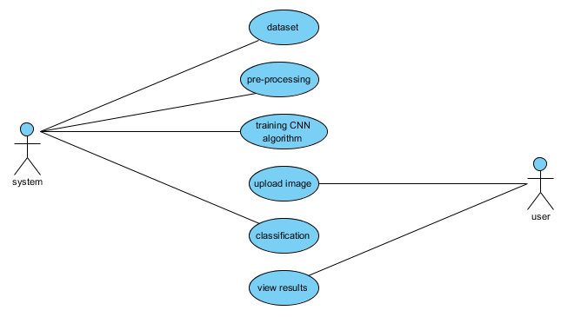

Slide 15
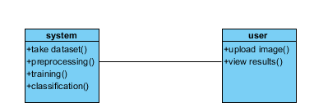
CLASS DIAGRAM
In software engineering, a class diagram in the Unified Modeling Language (UML) is a type of static structure diagram that describes the structure of a system by showing the system's classes, their attributes, operations (or methods), and the relationships among the classes. It explains which class contains information

Slide 16
SEQUENCE DIAGRAM
A sequence diagram in Unified Modeling Language (UML) is a kind of interaction diagram that shows how processes operate with one another and in what order.
It is a construct of a Message Sequence Chart. Sequence diagrams are sometimes called event diagrams, event scenarios, and timing diagrams.

Slide 17
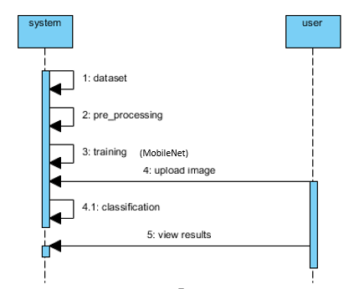

Slide 18
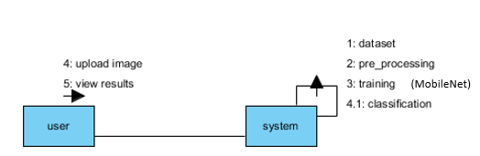
COLLABORATION DIAGRAM
In collaboration diagram the method call sequence is indicated by some numbering technique as shown below. The number indicates how the methods are called one after another. We have taken the same order management system to describe the collaboration diagram. The method calls are similar to that of a sequence diagram. But the difference is that the sequence diagram does not describe the object organization whereas the collaboration diagram shows the object organization.

Slide 19
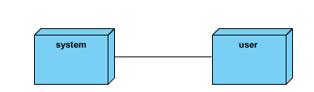
DEPLOYMENT DIAGRAM
Deployment diagram represents the deployment view of a system. It is related to the component diagram. Because the components are deployed using the deployment diagrams. A deployment diagram consists of nodes. Nodes are nothing but physical hardware’s used to deploy the application.

Slide 20
ACTIVITY DIAGRAM
Activity diagrams are graphical representations of workflows of stepwise activities and actions with support for choice, iteration and concurrency. In the Unified Modeling Language, activity diagrams can be used to describe the business and operational step-by-step workflows of components in a system. An activity diagram shows the overall flow of control.

Slide 21
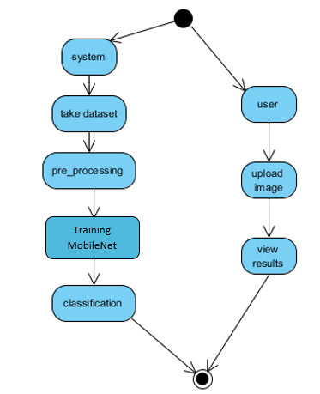

Slide 22
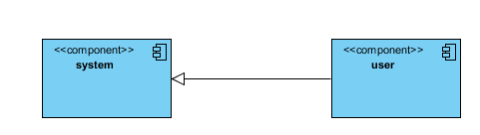
COMPONENT DIAGRAM
A component diagram, also known as a UML component diagram, describes the organization and wiring of the physical components in a system. Component diagrams are often drawn to help model implementation details and double-check that every aspect of the system's required function is covered by planned development.

Slide 23
ER DIAGRAM
An Entity–relationship model (ER model) describes the structure of a database with the help of a diagram, which is known as Entity Relationship Diagram (ER Diagram). An ER model is a design or blueprint of a database that can later be implemented as a database. The main components of E-R model are: entity set and relationship set.
An ER diagram shows the relationship among entity sets. An entity set is a group of similar entities and these entities can have attributes. In terms of DBMS, an entity is a table or attribute of a table in database, so by showing relationship among tables and their attributes, ER diagram shows the complete logical structure of a database. Let’s have a look at a simple ER diagram to understand this concept.

Slide 24
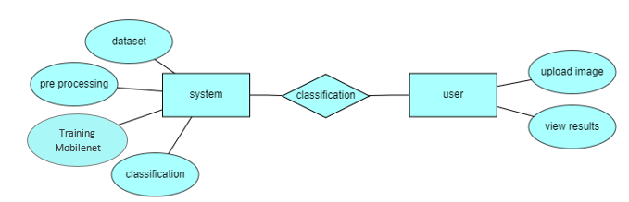

Slide 25
DFD DIAGRAM
A Data Flow Diagram (DFD) is a traditional way to visualize the information flows within a system. A neat and clear DFD can depict a good amount of the system requirements graphically. It can be manual, automated, or a combination of both. It shows how information enters and leaves the system, what changes the information and where information is stored. The purpose of a DFD is to show the scope and boundaries of a system as a whole. It may be used as a communications tool between a systems analyst and any person who plays a part in the system that acts as the starting point for redesigning a system.

Slide 26
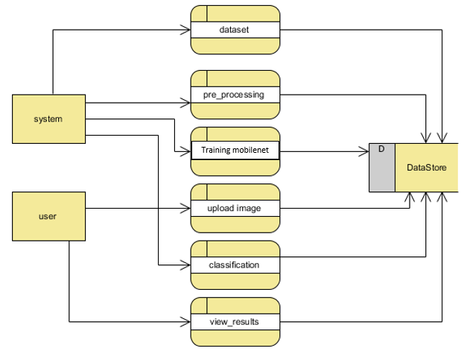

Slide 27
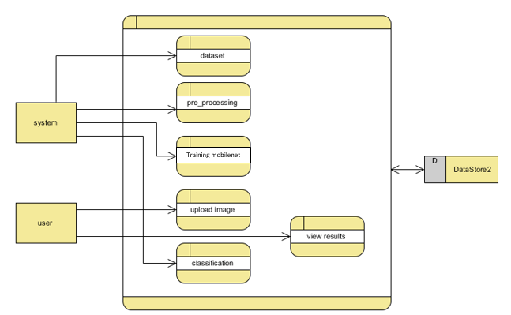

Slide 28
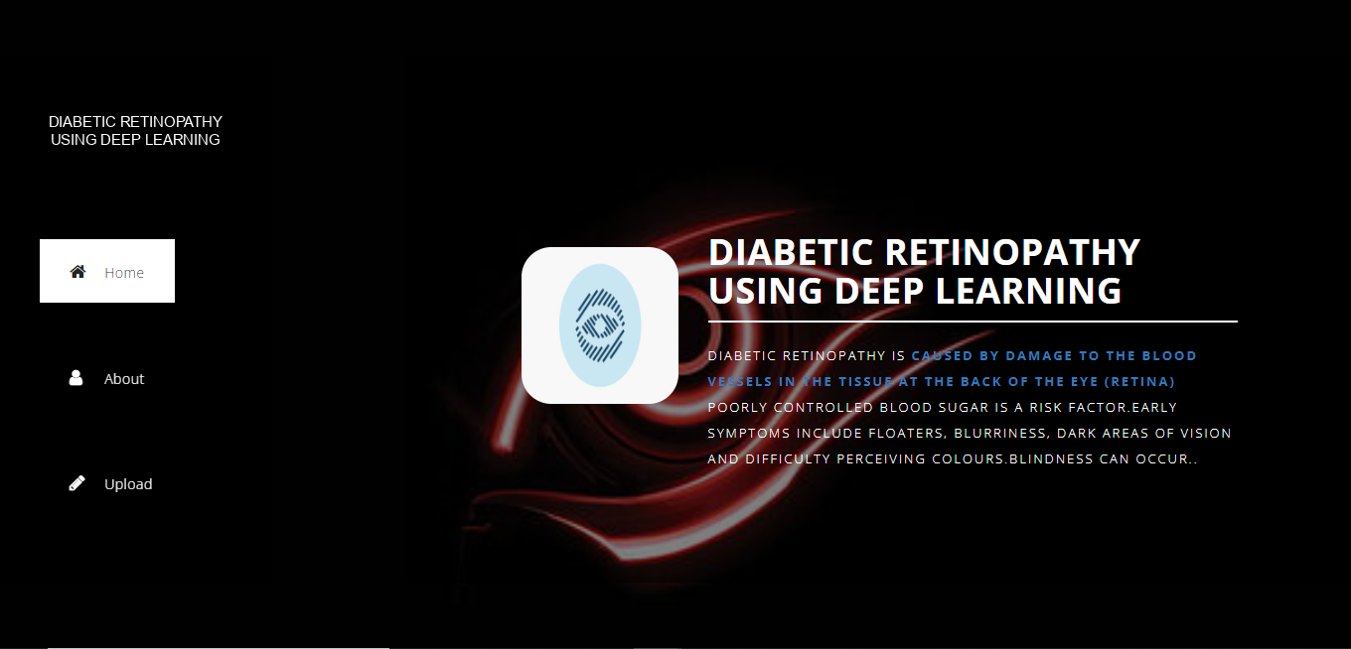
RESULTS
HOME PAGE: This is the home page of the Diabetic Retinopathy.

Slide 29
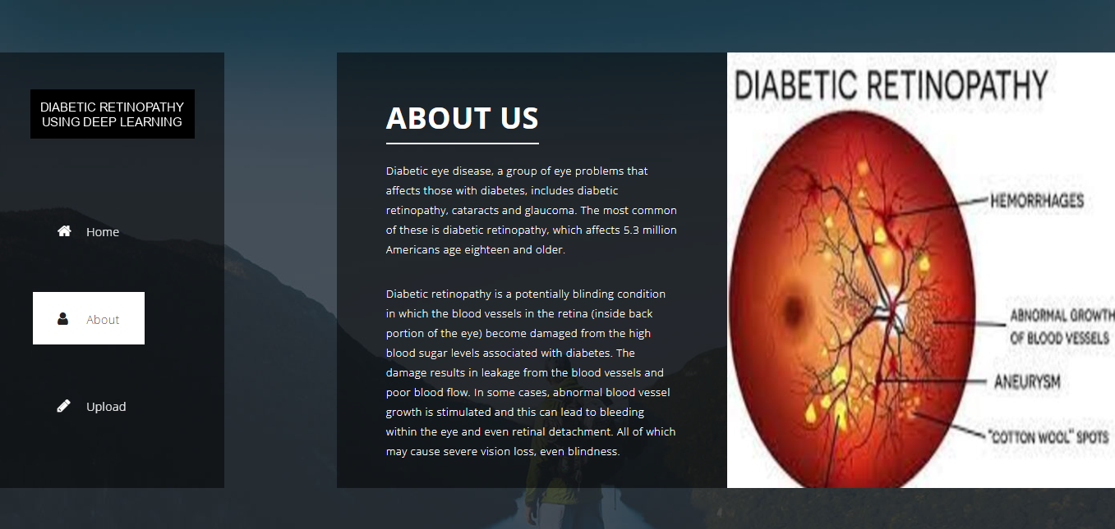
ABOUT PAGE: This is the brief introduction of Diabetic Retinopathy.

Slide 30
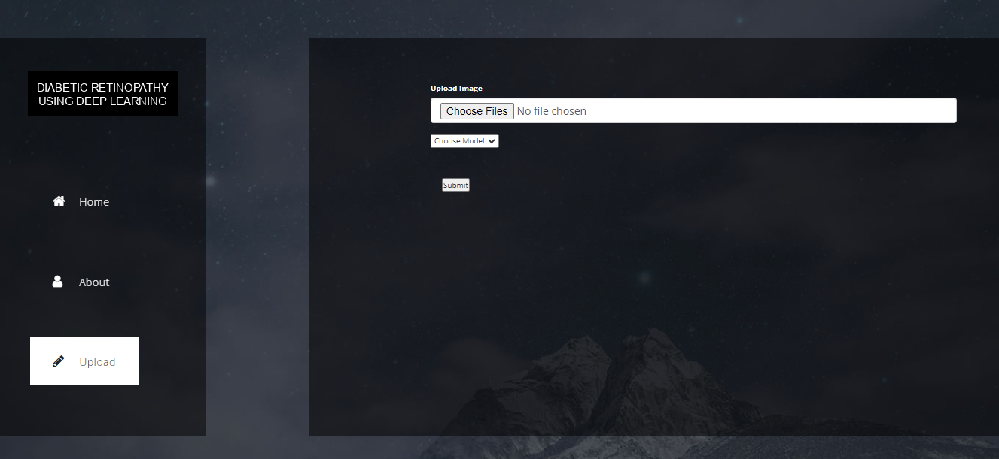
UPLOAD PAGE: This the upload page, here we can upload the image.

Slide 31
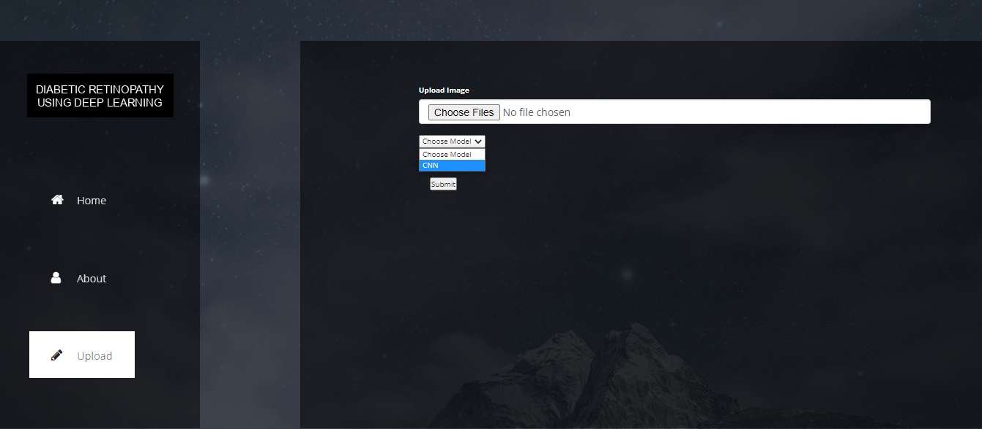
MODEL SELECTION PAGE: Here we can select the model.

Slide 32
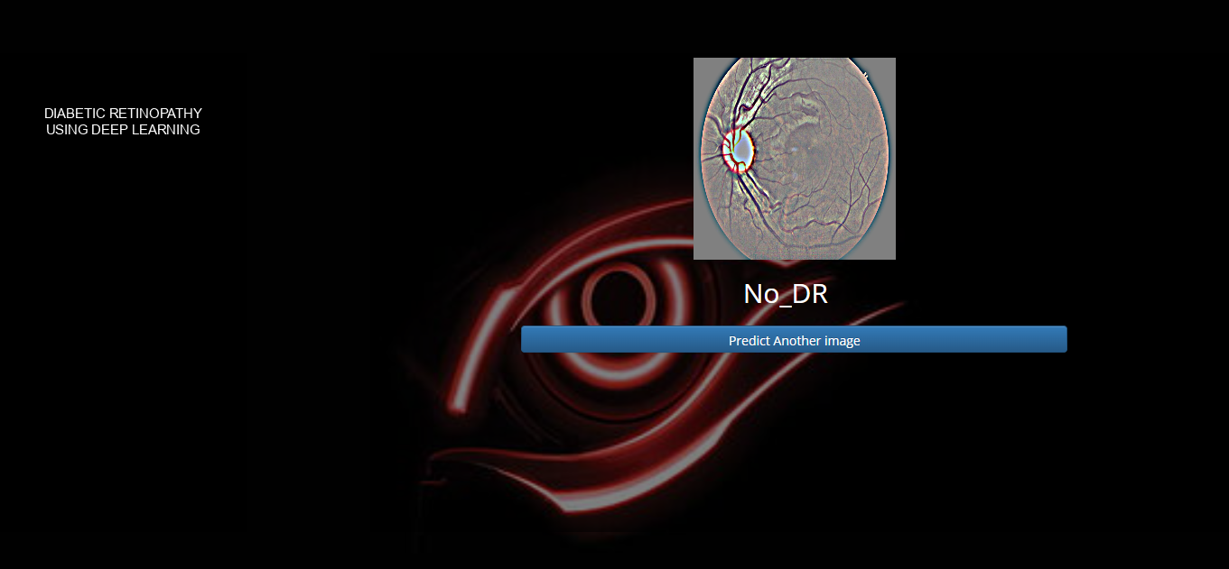
Classify output 1:

Slide 33
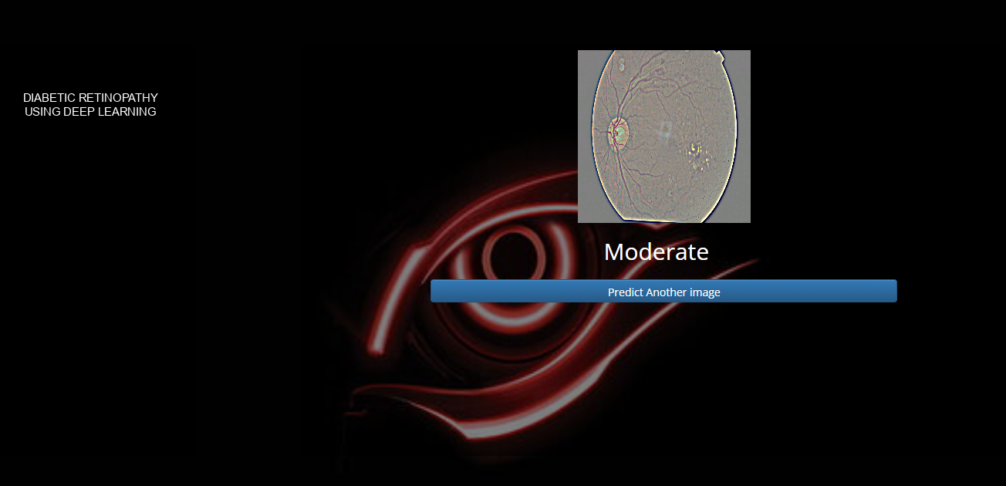
Classify output 1:

Slide 34
CONCLUSION
In this project we have successfully classified the images of Identification of diabetic retinopathy, are either affected with the diabetic retinopathy or not using the deep learning and machine learning. Here, we have considered the dataset of diabetic retinopathy images which will be of different types (healthy or unhealthy) and trained using MobileNet. After the training we have tested by uploading the image and classified it.

Slide 35
FUTURE SCOPE
This can be utilized in future to classify the types of different Deficiencies easily that which can tend to easy to Predicated the retinopathy for diabetic in early stages and can take the initial curing of human and take measures to not affect.

Slide 36
REFERENCES
Varun Gulshan, Subhashini Venugopalan, Rajiv Raman, “Development and Validation of a Deep Learning Algorithm for Detection of Diabetic Retinopathy in Retinal Fundus Photographs,” JAMA. 2016;316(22):24022410. doi:10.1001/jama.2016.17216.
Kele Xu, Dawei Feng, and Haibo Mi, “Deep Convolutional Neural Network-Based Early Automated Detection of Diabetic Retinopathy Using Fundus Image,” Received: 10 November 2017; Accepted: 22 November 2017; Published: 23 November 2017.
Sheikh Muhammad Saiful Islam, Md Mahedi Hasan, and Sohaib Abdullah, “Deep Learning based Early Detection and Grading of Diabetic Retinopathy Using Retinal Fundus Images,” arXiv:1812.10595v1 [cs.CV] 27 Dec 2018.
Lam C, Yi D, Guo M, Lindsey T., “Automated Detection of Diabetic Retinopathy using Deep

Slide 37
Learning,” AMIA Jt Summits Transl Sci Proc. 2018 May 18;2017:147-155. PMID: 29888061; PMCID: PMC5961805.
Sara Hosseinzadeh Kassani, Peyman Hosseinzadeh Kassani, Reza Khazaeinezhad, Michal J. Wesolowski et al. "Diabetic Retinopathy Classification Using a Modified Xception Architecture", 2019 IEEE International Symposium on Signal Processing and Information Technology (ISSPIT), 2019 .
Anuj Jain, Arnav Jalui, Jahanvi Jasani, Yash Lahoti, Ruhina Karani. "Deep Learning for Detection and Severity Classification of Diabetic Retinopathy", 2019 1st International Conference on Innovations in Information and Communication Technology (ICIICT), 2019
R Borys Tymchenko, Philip Marchenko and Dmitry Spodarets, “Deep Learning Approach to Diabetic Retinopathy Detection”.
Weiguo Fan, Edward A. Chandan K. Reddy, “A Deep Learning Based Pipeline for Image Grading of Diabetic Retinopathy”.

Slide 38
Thank You

